Slide 1
Car Number Plate Detection
Parul Institute of Computer Applications
Semester 5 Project
2020-21
Team members
Jeet Sampat : 19051010101147
Tariro Chibwe : 19051010101125
Nipun Bhardwaj : 19051010101111
Guided by: Hana Choksi

Slide 2
INDEX
Abstract
Comparison of New System with Existing System
Technology and HW, SW Requirement Specification
Modules and its short description
Users and their role description
Class diagram
Activity diagram
Use Case
DFD
ER Diagram
Data Dictionary
Development Phase -1 Screenshots(layout / form designing)
Development Phase -2 Screenshots(layout / form design with code)
Development Phase -3 Screenshots(layout / form design with validation)
Development Phase -4 Screenshots(System with Testing)
Limitations
Future Enhancement
References & Bibliography

Slide 3
Abstract
Managing the parking system and the noting down the cars entering inside the mall parking.
In this system the noting down the cars entering will be done by the automated system so the task of the security guard will be easier.
This system uses OpenCV libraries to get the photos of the cars and OCR library converts the photo to text.
This system takes the cars photo while entering and gives them a receipt for the parking and while exiting the mall they should provide the receipt number and the then the system will provide the payment.

Slide 4
Comparison of new system with existing system
This system recognises the number. plate of the car from the photo.
This system gives the number of parking left in the parking area.
This system stores the details of the car in the database.
This system provides the cost of parking during exit time.

Slide 5
Technology and HW, SW Requirement Specification
Hardware Requirements:
Processor – i5 8Gen
RAM - 4GB
Camera- HD 1880p
Storage- 1TB HDD
Touch Screen
Software Requirements:
OS: Windows 10
Software: Python 3.9
Libraries: OpenCV, OCR, NumPy, mysql-connecter, imutils, os, matplotlib
Database: MySQL

Slide 6
Modules and its short description
Entry module: The customer will select the button and get the receipt
Exit Module: The customer will select the button and enter the respite details and pay the amount.
ID Card Generation: During inserting the new security guard details its ID card will generated by the system.
Attendance Module: This module will take the attendance of the security guard
Details check: This module will provide the details of the cars entered and number of cars and time and date.
Login Module: The admin and the security guard can login.
Payment Module: This module allows you to pay for the parking space allocated by the system to the customer.

Slide 7
Users and their role description
Admin: The admin can check the details of the cars and can even check the photos of the cars clicked.
Security Guard: The user will be security guard or the person managing the parking area of the mall. He will start the system at the starting of his shift.
Customers: While entering the mall the customer will use the entry module in which they will get a receipt and during exit they will use the exit module in which have to input the receipt details and pay the amount.

Slide 8
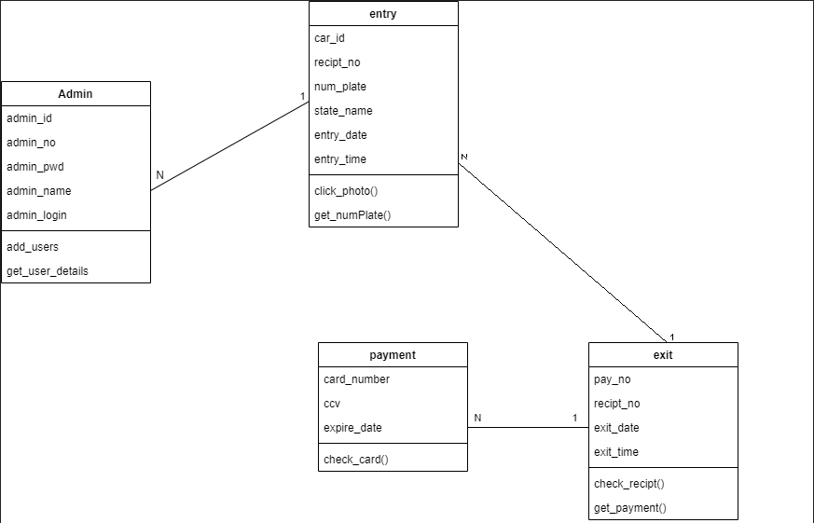
Class diagram

Slide 9
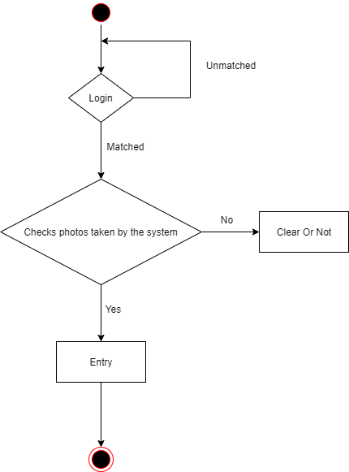
Activity diagram: Security Side

Slide 10
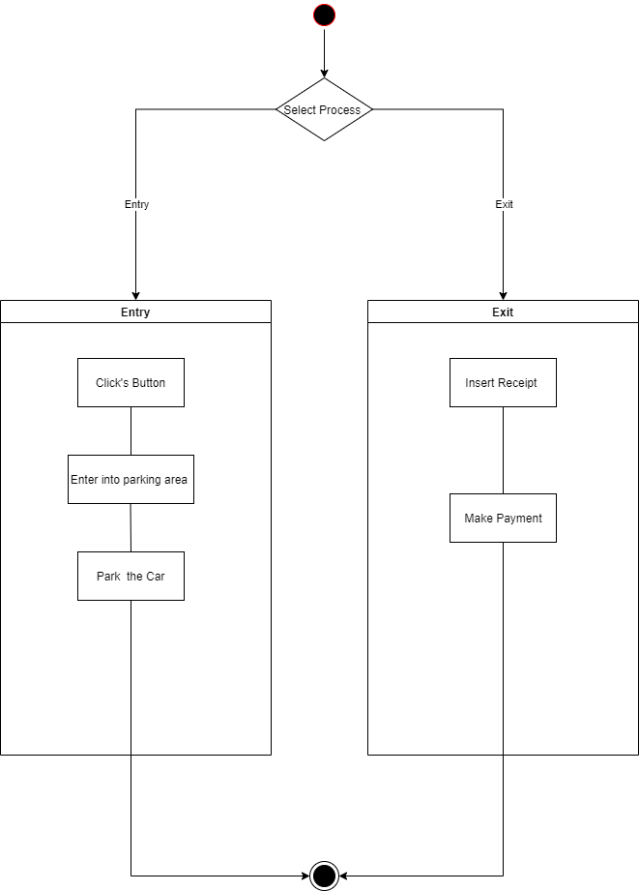
Activity diagram: Visitor Side

Slide 11
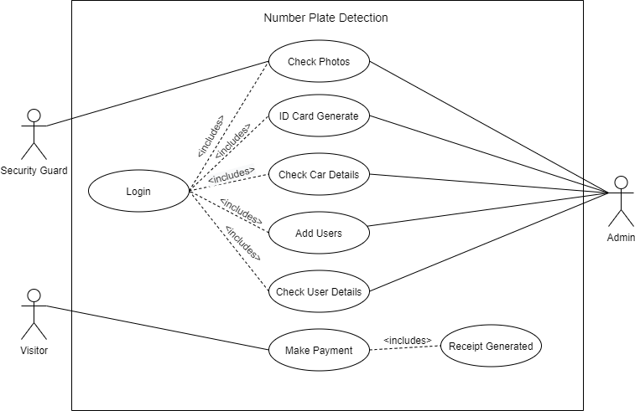
Use case diagram

Slide 12
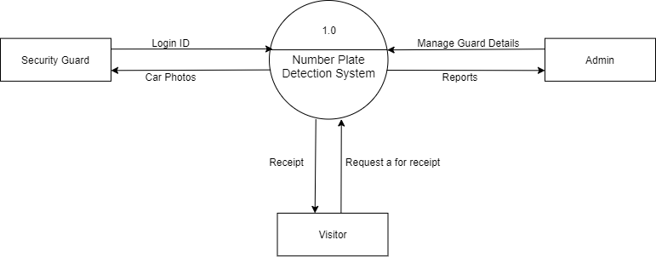
DFD: Context level

Slide 13
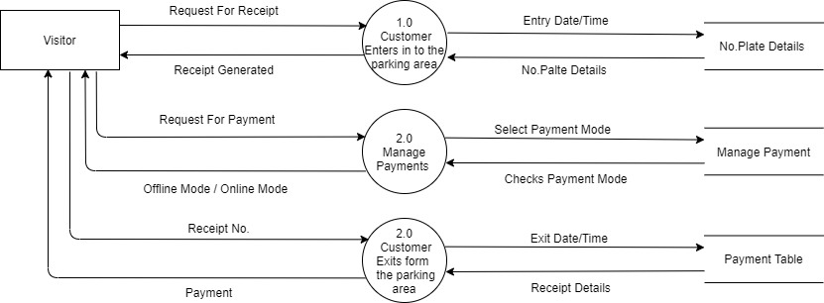
DFD : Level-1 Visitor Side:

Slide 14
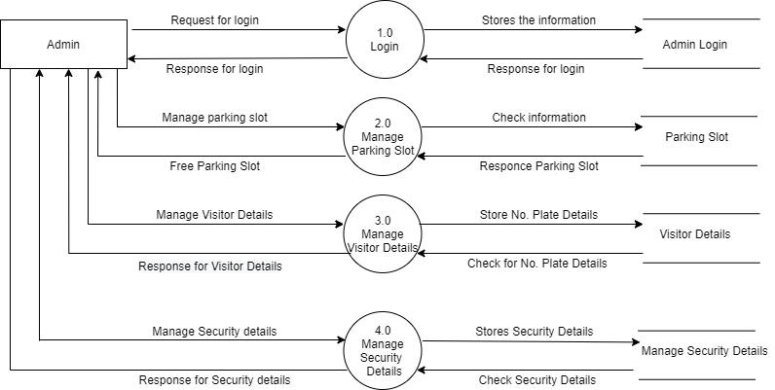
DFD: Level-1 Admin Side

Slide 15
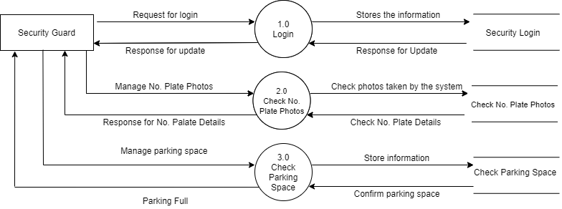
DFD: Level-1 Security Side

Slide 16
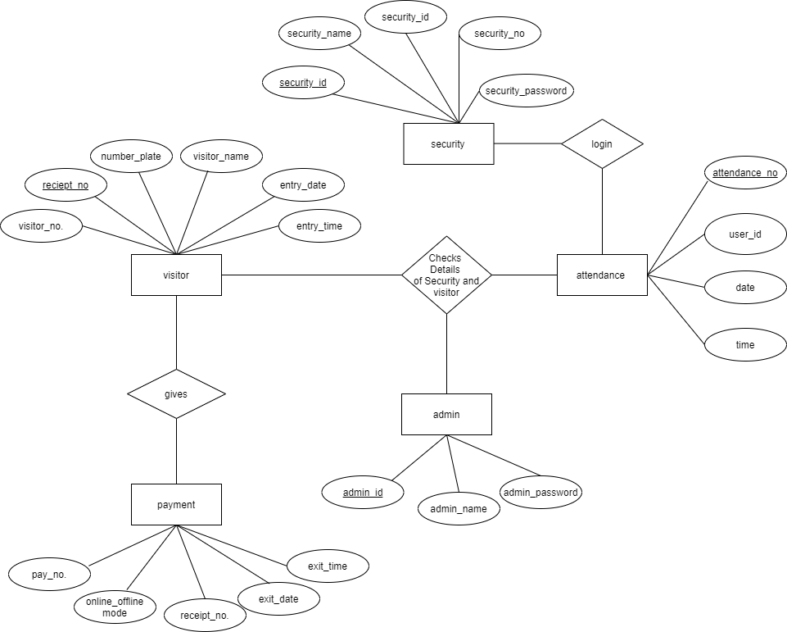
ER diagram:

Slide 17
DATA DICTONARY: Admin_Table:
:
Sr.No | Field Name | Size | Description | Constraint | Example
1 | Admin_id | Varchar (5) | ID of Admin | P.K | ad100, ad101
2 | Admin_Name | Varchar (25) | Name of the Admin | Not Null | Jeet , Nipun, Tariro
3 | Admin_pass | Varchar (32) | Password for Login | Not Null | 666666, ad12345

Slide 18
DATA DICTONARY: User_Table:
Sr.No | Field Name | Size | Description | Constraint | Example
1 | User_Id | Varchar(5) | ID of User | P.K | u100, u101
2 | User_Name | Varchar (25) | Name of the User | Not Null | Jeet, Nipun, Tariro
3 | Phone_no | Number(10) | Number of the user | Not Null
4 | Email_id | Varchar(50) | Email id of the user | Not Null
5 | User_Pass | Number (6) | Password for Login | Not Null | 666666, ad12345

Slide 19
DATA DICTONARY: Attendance_Table
Sr.No | Field Name | Size | Description | Constraint | Example
1 | attendance_no | Varchar(5) | Attendance no | P.K | a100, a102
2 | User_id | Varchar (5) | ID of User | F.K | u100, u101
3 | Time | Time | Time of attendance | Not Null | 12:58:36
4 | Date | Date | Date of attendance | Not Null | 12/07/2021

Slide 20
DATA DICTONARY: Car_Table:
Sr.No | Field Name | Size | Description | Constraint | Example
1 | Sr_no | Varchar (5) | Sr.no of the car | U. K | 1, 2, 3, ….
2 | Receipt_no | Varchar (5) | Receipt no of the car | P. K | Rt101,
3 | Num_Plate | Varchar (15) | No. plate of the car | Not Null | GJ062135
4 | State_Name | Varchar (25) | State of the no. plate | Not Null | Gujarat, Mumbai, etc.
5 | En_Date | Date | Date of entry | Not Null | 17/6/2021
6 | En_Time | Time | Time of entry | Not Null | 20:21

Slide 21
DATA DICTONARY: Payment_ Table:
Sr.No | Field Name | Size | Description | Constraint | Example
1 | Pay_no | Number(5) | Pay number of the cars | P. K, A.I | 3215
1 | Receipt_no | Varchar (5) | Receipt no of the car | F. K | Rt101,
2 | Exit_date | date | Exit date of the | Not Null | 12/9/2021
3 | Exit_time | time | Exit time of the | Not Null | 12:01

Slide 22
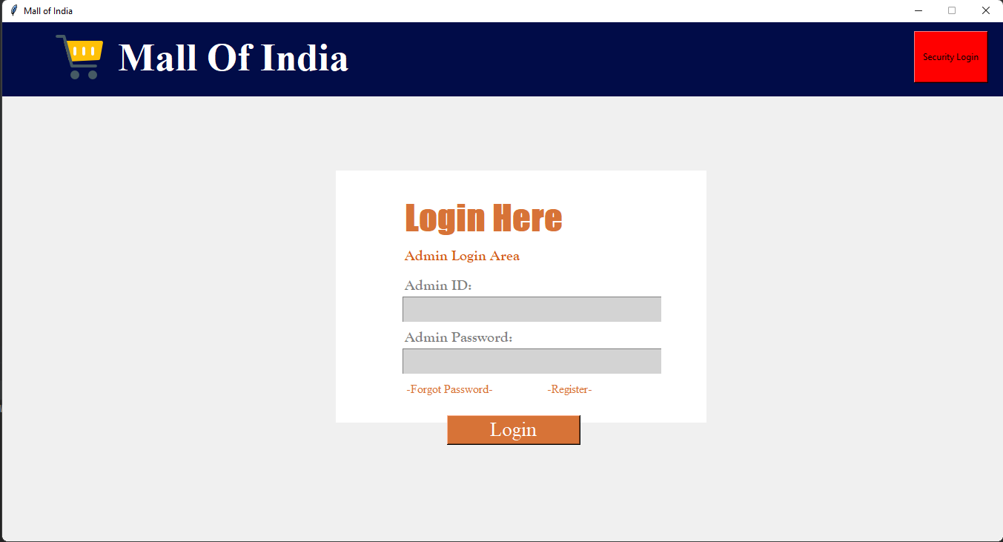
Development Phase -1 Screenshots(layout / form designing)

Slide 23
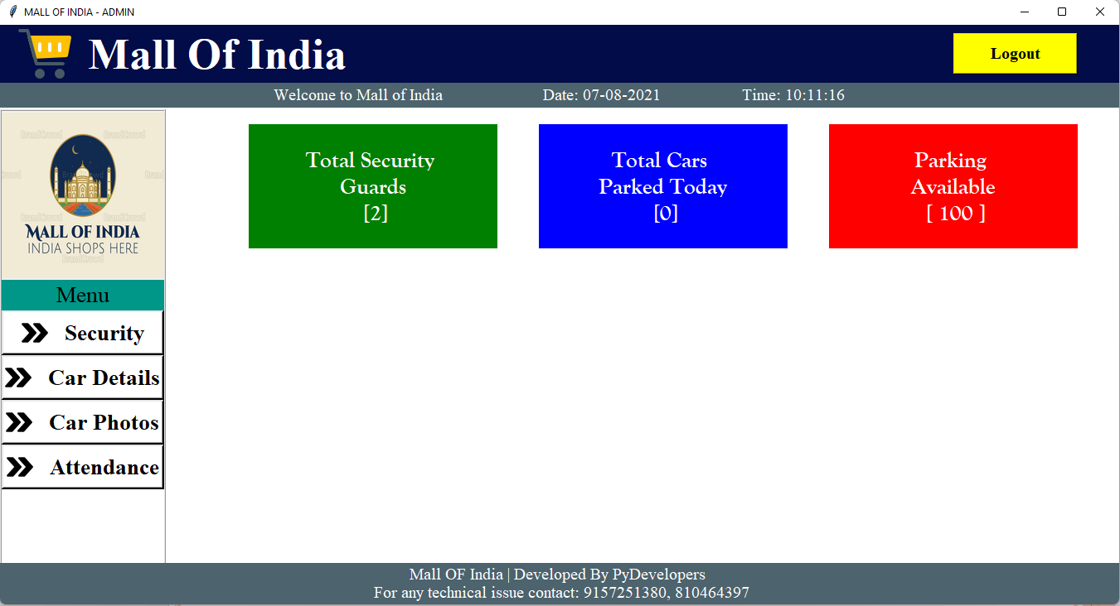
Development Phase -1 Screenshots(layout / form designing)

Slide 24
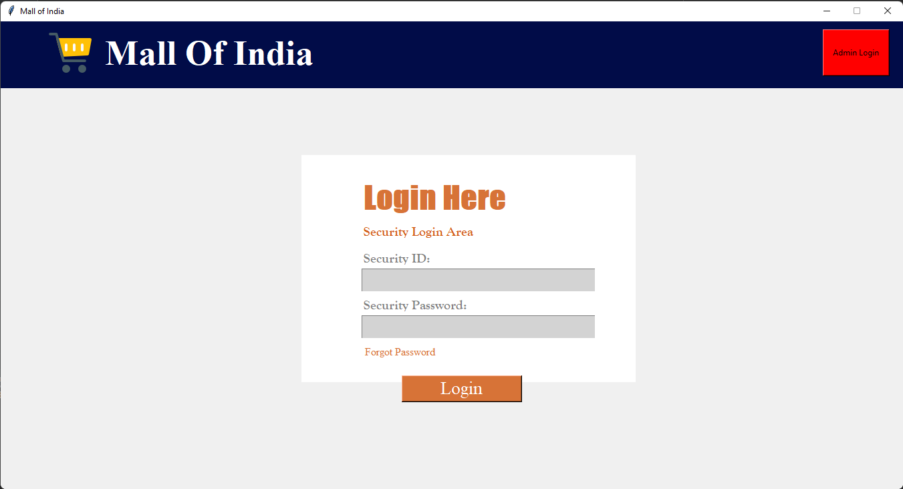
Development Phase -2 Screenshots(layout / form design with code)

Slide 25
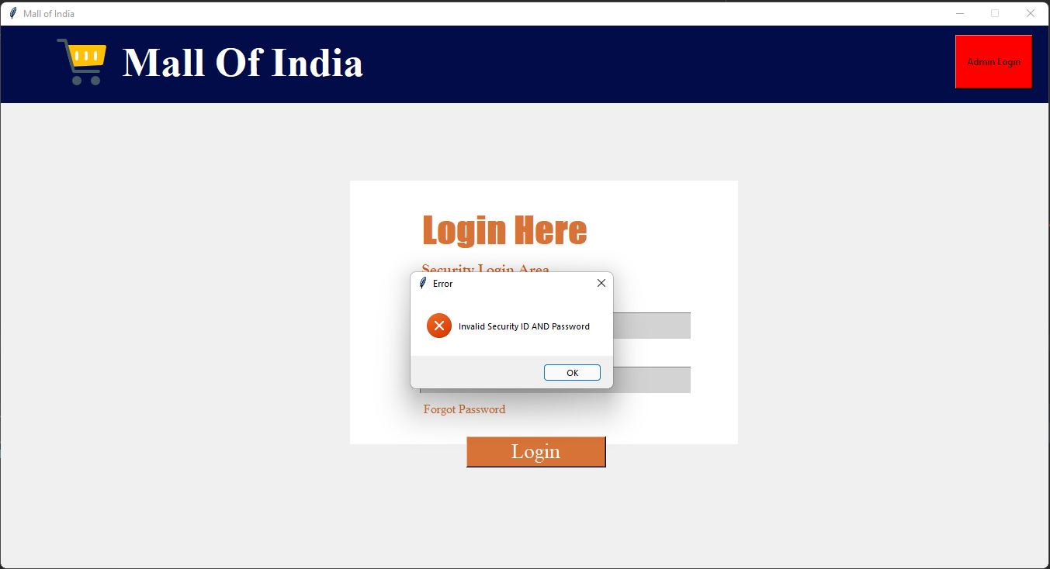
Development Phase-3 Screenshots (layout / form designing with validation)

Slide 26
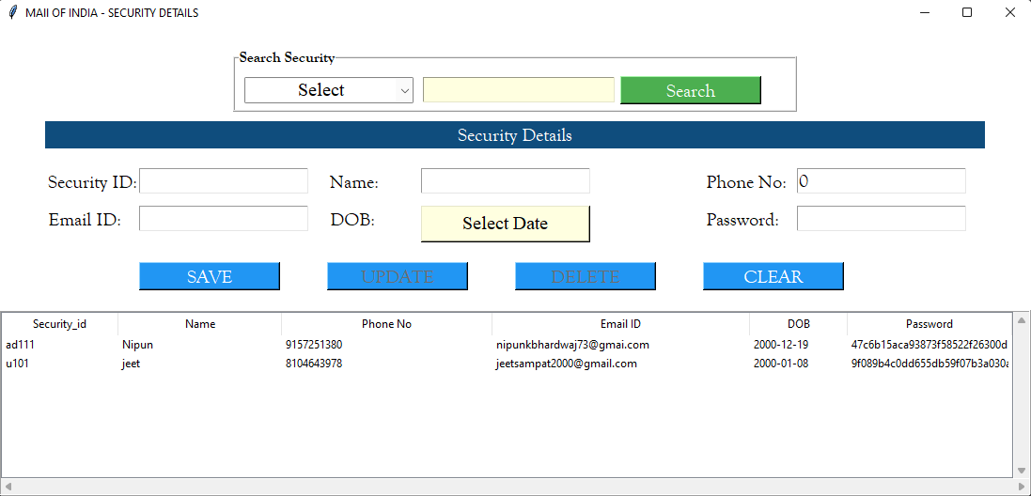
Development phase- 4 Screenshots:

Slide 27
Limitations
The algorithm may not be so perfect as some text may not be clear.
We must require a high-resolution camera.
The picture quality should be clear.

Slide 28
Future Enhancement
In future we may even add image processing for better recognition.
The video of the car entering that will be store.
We can use this system in university and colleges in future also.

Slide 29
References & Bibliography
https://opencv.org/
https://pyorc.readthedocs.io/en/latest/#:~:text=PyORC%20is%20a%20Python%20module,in%20the%20Python%20standard%20library.&text=The%20module%20is%20compatible%20with%20Python%203.6%20or%20newer%20releases
https://medium.com/programming-fever/license-plate-recognition-using-opencv-python-7611f85cdd6c

Slide 30
Thankyou…!!!
Number Plate Detetion Word.docx

